Slide 1
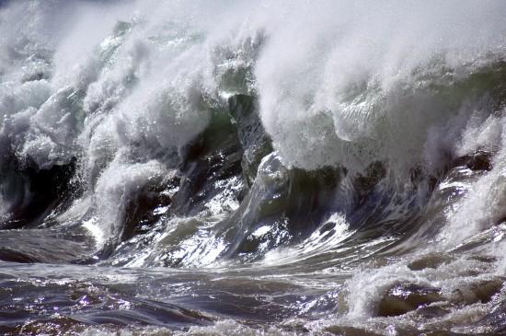
6. Tsunami, wave of destruction

Slide 2
6: Tsunami, wave of destruction
By the end of the lesson you should be able to:
Define a Tsunami and identify the origins of the word.
Describe how a Tsunami forms.
Explain why a Tsunami grows in height as it approaches the shore.
Give examples of the destruction and loss of life caused by 2004 Boxing Day Tsunami.

Slide 3
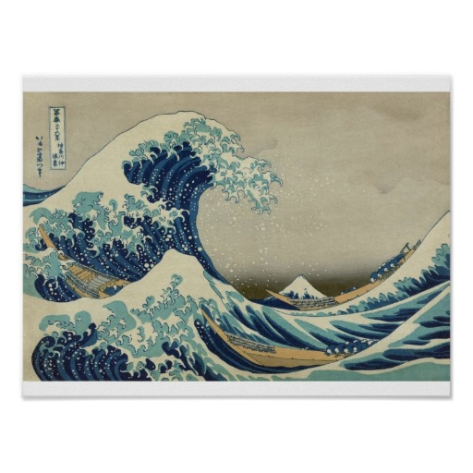
What is a Tsunami?
A Tsunami is a series of waves (called a ‘wave train’) made in a body of water by a sudden disturbance.
The term Tsunami comes from the Japanese language meaning ‘harbour wave’.
This sudden disturbance pushes a large column of water upwards creating a Tsunami.
Tsunamis are also called ‘seismic sea waves’ or ‘tidal waves’.

Slide 4
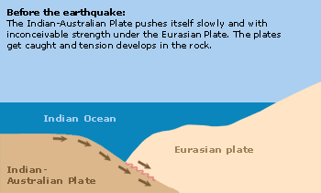
How a Tsunami forms
On 26th December 2004 a Tsunami formed by an underwater earthquake engulfed Indonesia, Sri Lanka, the Seychelles, Thailand and India. This is how the Tsunami formed
Before the earthquake the Indian-Australian Plate pushes itself under the Eurasian Plate.
The plates get caught and tension develops in the rock.
Indian Ocean
Eurasian Plate
Indian-Australian Plate

Slide 5
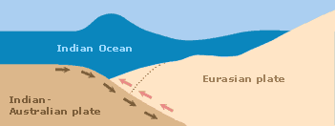
How a Tsunami forms
During the earthquake the enormous tension at the edge of the Eurasian Plate becomes too great.
The edge of the plate comes loose and shoots back to its’ starting position.
The built up tensions suddenly release in an abrupt movement which can be felt as an earthquake.
Indian Ocean
Eurasian Plate
Indian-Australian Plate

Slide 6
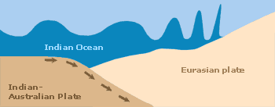
How a Tsunami forms
After an earthquake the sea bed can move several metres up.
The water above the plate’s edge is displaced in a short time.
The Tsunami that forms, spreads out in a circular movement
Indian Ocean
Eurasian Plate
Indian-Australian Plate

Slide 7
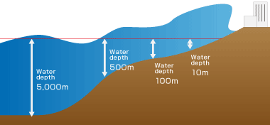
Why did the Tsunami grow in height as it approached the shore?
Out in the ocean where the Tsunami formed, the water was deep.
In deep water the Tsunami ran fast but the wave was small.
The front of the wave slows down as it approaches the shore.
The back of the wave still goes its original speed
So the wave builds in size until it hits the shore.

Slide 8
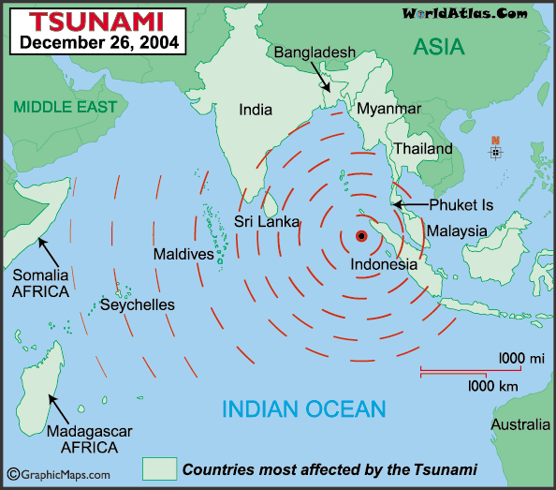
The Tsunami was caused by an earthquake, just off the west coast of Sumatra

Slide 9
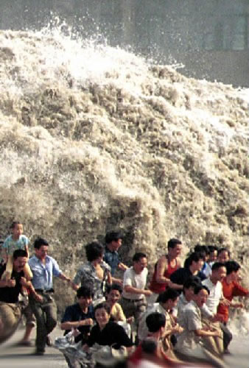
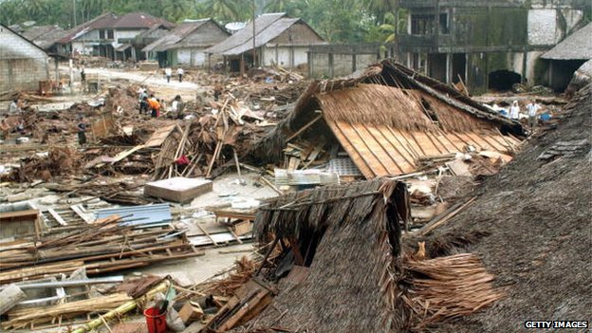
By the end of the day of the 2004 Indian Ocean tsunami, it had already killed 150,000 people. The final death toll was 283,000.
The Indian Ocean tsunami travelled 3,000 miles to Africa and still arrived with sufficient force to kill people and destroy property.
Many people in Indonesia saw animals fleeing to high ground minutes before the tsunami hit. Very few animal bodies were found afterward.
The risk of famine and disease was high following the tsunami – bodies rotting in the tropical heat, contaminated food and water.
1.7 million people displaced (had their homes destroyed) by the Tsunami.

Slide 10
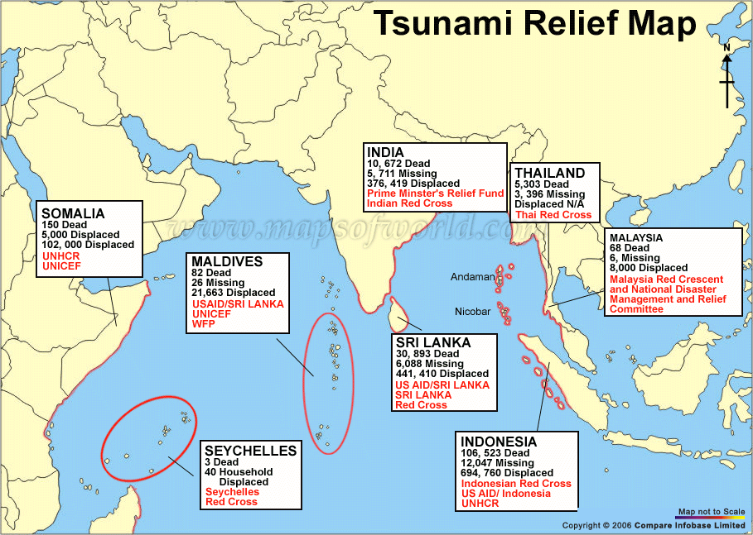

Slide 11
Show what you have learned
1. Explore what the word Tsunami means and find out which country it originated from.
2. Draw a series of diagrams to describe how a Tsunami forms.
3. Explain why a Tsunami grows in height as it approaches the shore.
4. Describe the destruction caused by the 2004 Boxing Day Tsunami and list the loss of life in each country affected by the disaster.

